Slide 1



Project 2
Group Members: Sabyasachi Das, Daniel Russell, Stefany Lima

Slide 2


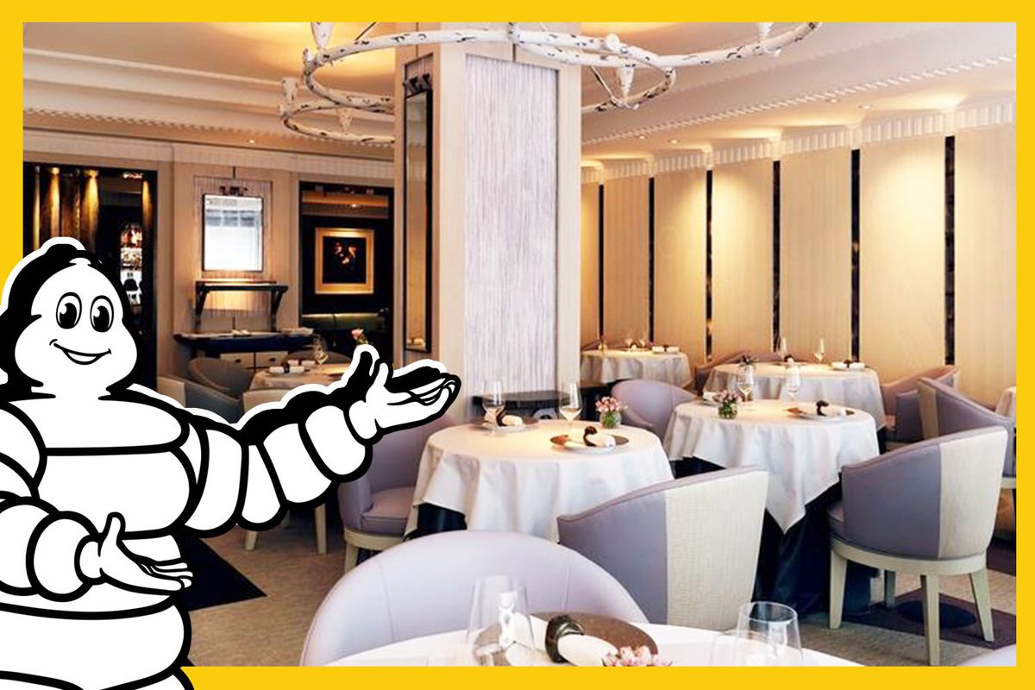
Customer Intro
The MICHELIN Guide was initially used to encourage motorists to visit restaurants while traveling.
Over time, stars and growing distinction were awarded to fine dining establishments
At first, only 1 Star was awarded, but now 3 Stars is the maximum distinction
World-renowned chefs and attractions

Slide 3
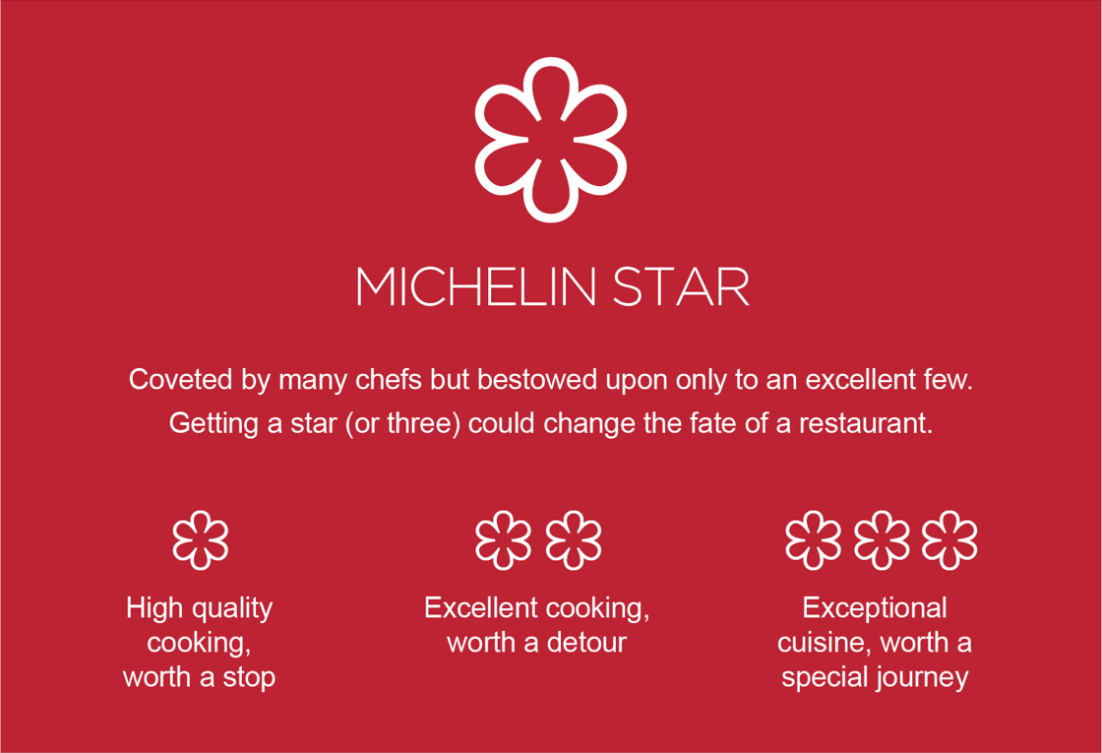
Overview
Our team aimed to explored how Michelin starred restaurants were distributed among the world’s regions.
World Map
Filter by Regions
Restaurant summary
Cuisine
Categories
Frequency
Star rating and Price
Combination occurrences

Slide 4

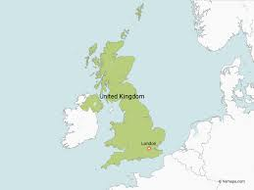
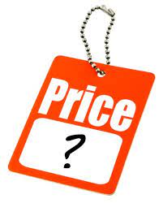
Assumptions & Limitations
Dataset from 2019
Pre COVID and resulting impact on hospitality industry could result in closures or score changes
Limited data
No data available for all world countries
No price information from the UK so we had to drop N/A
Price scale
Priciness indicated by number of $ signs can be confusing for clients
$ (1) to $$$$$ (5)

Slide 5
DEMO
Visit our site!

Slide 6

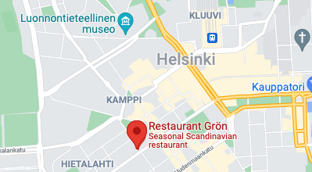
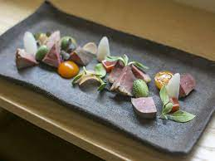
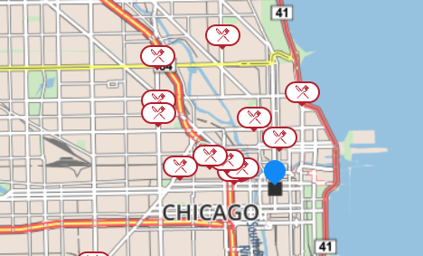
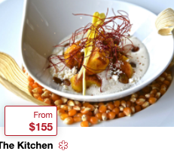
Future Plan
Moving forward, we would like:
More data available
Implement ability for customers to filter visualizations further by cuisine, region, price, and stars
Explore options more locally
Intuitive legends for more info

Slide 7
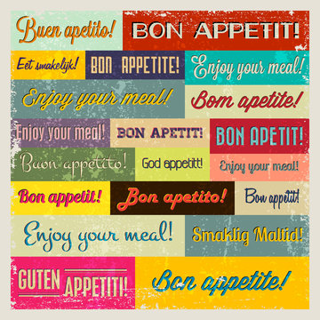

Thank You!
Any questions?

